Slide 1
Set-UID Privileged Programs

Slide 2
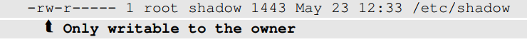
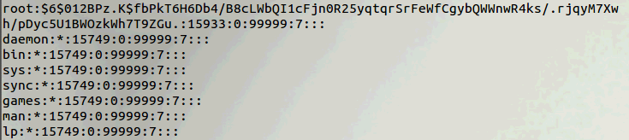
Need for Privileged Programs
Password Dilemma
Permissions of /etc/shadow File:
How would normal users change their password?
Notes:
Should be able to write to a particular section of a protected file , Example: Shadow File
Can be done using Privileged programs
Daemons
Set-UID Programs

Slide 3
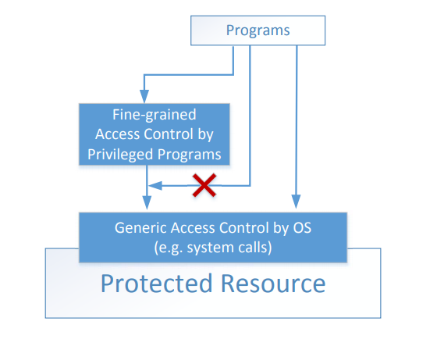
Two-Tier Approach
Implementing fine-grained access control in operating systems make OS over complicated.
OS relies on extension to enforce fine-grained access control
Privileged programs are such extensions

Slide 4
Types of Privileged Programs
Daemons
Computer program that runs in the background
Needs to run as root or other privileged users
Set-UID Programs
Widely used in UNIX systems
Program marked with a special bit

Slide 5

Superman Story
Power Suit
Superpeople: Directly give them the power
Issues: bad superpeople
Power Suit 2.0
Computer chip
Specific task
No way to deviate from pre-programmed task
Set-UID mechanism: A Power Suit mechanism implemented in Linux OS

Slide 6
Set-UID Concept
Allow user to run a program with the program owner’s privilege.
Allow users to run programs with temporary elevated privileges
Example: the passwd program
$ ls -l /usr/bin/passwd
-rwsr-xr-x 1 root root 41284 Sep 12 2012 /usr/bin/passwd

Slide 7
Set-UID Concept
Every process has two User IDs.
Real UID (RUID): Identifies real owner of process
Effective UID (EUID): Identifies privilege of a process
Access control is based on EUID
When a normal program is executed, RUID = EUID, they both equal to the ID of the user who runs the program
When a Set-UID is executed, RUID ≠ EUID. RUID still equal to the user’s ID, but EUID equals to the program owner’s ID.
If the program is owned by root, the program runs with the root privilege.
Notes:
Explanation of different types of user id
Relationship showing changes in RUID and EUID for user SEED when they run a program which is owned by themselves, by MARY and by ROOT.

Slide 8
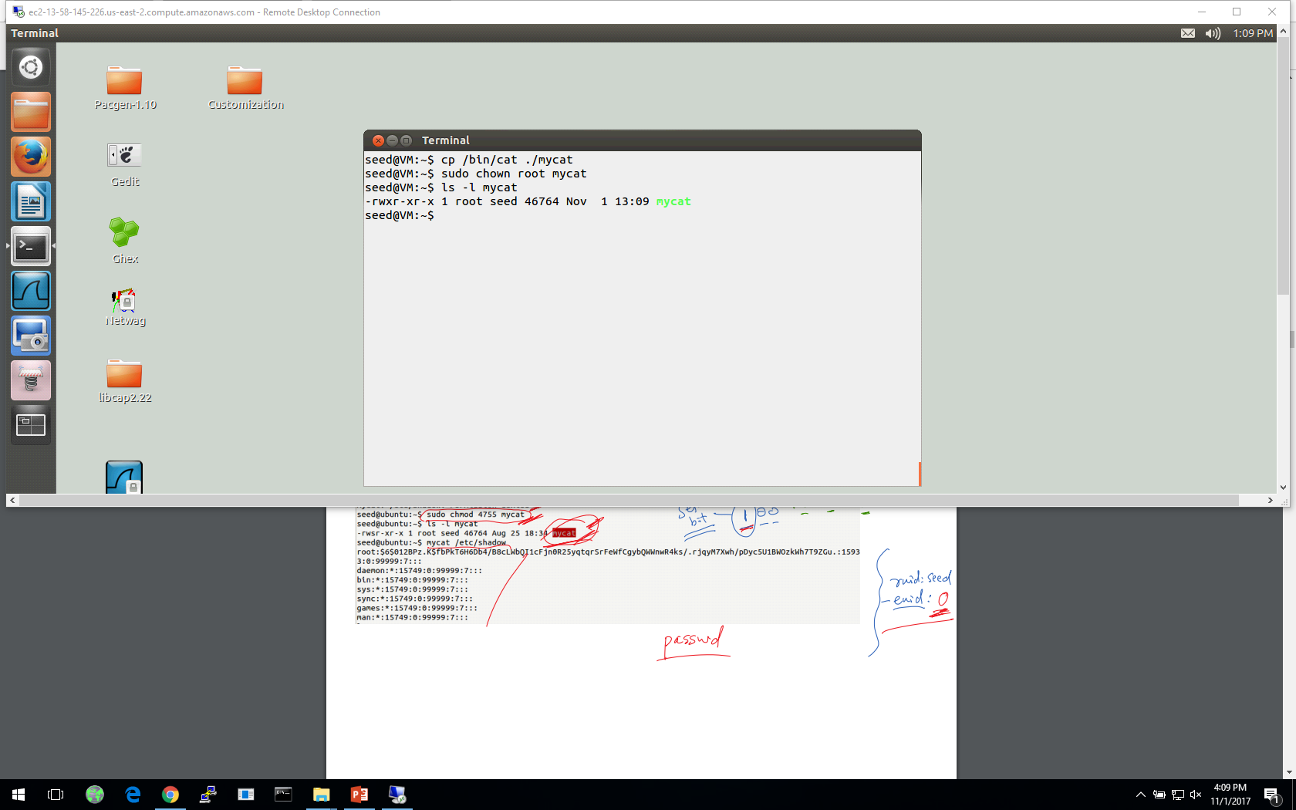
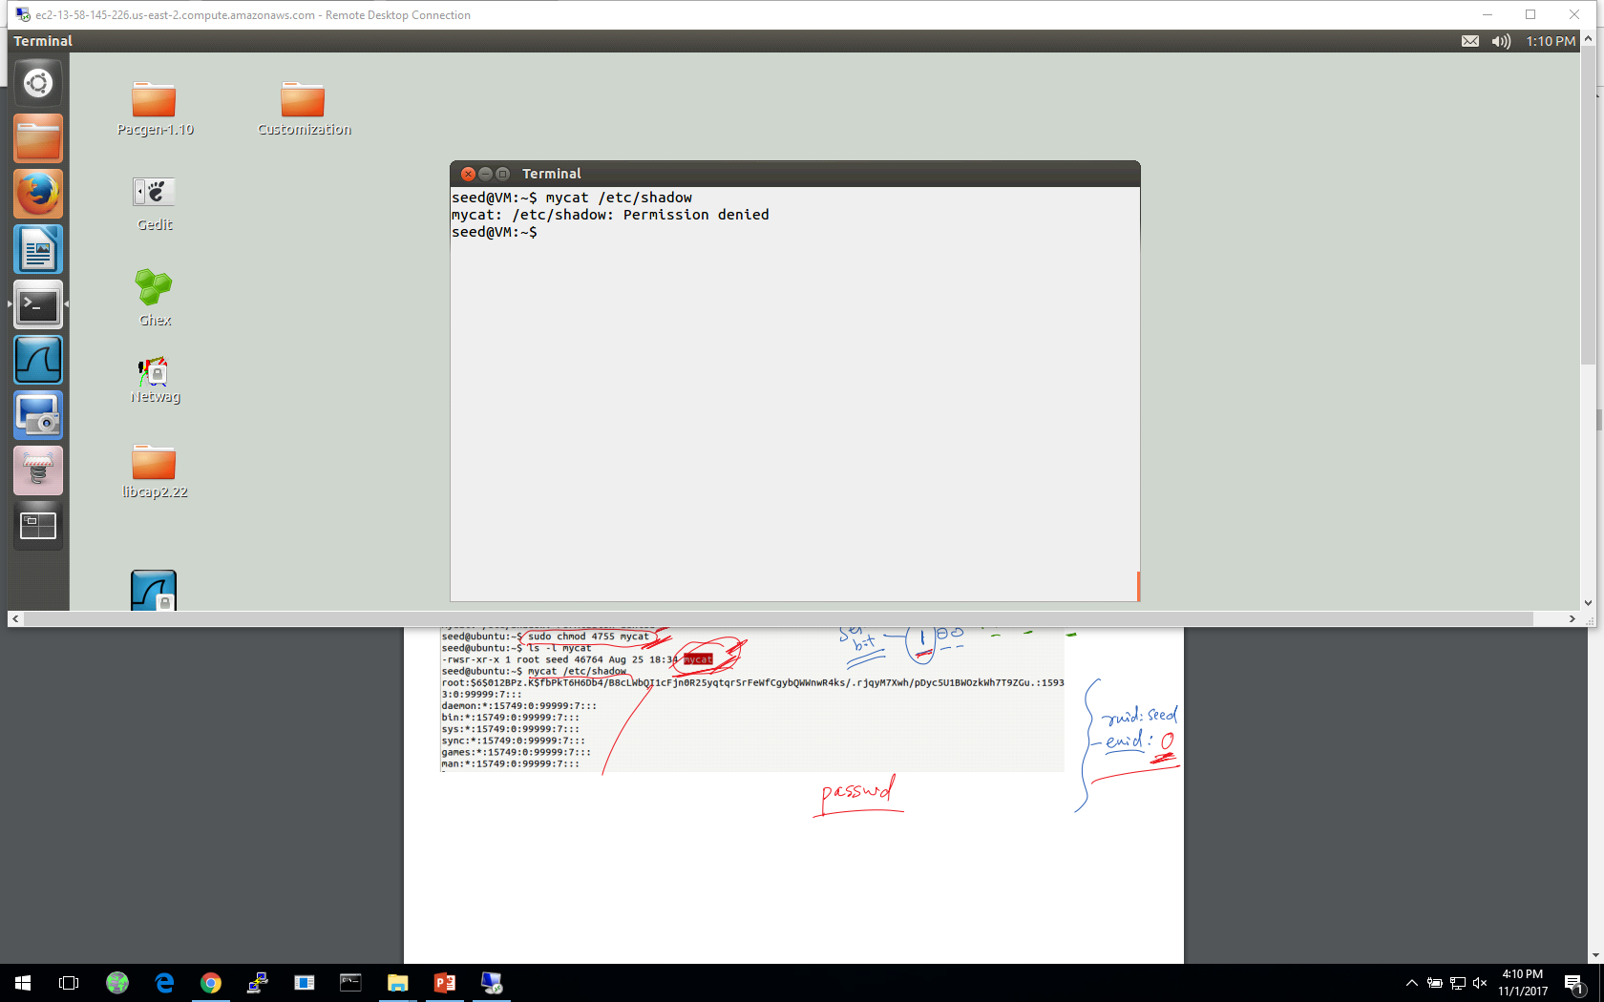
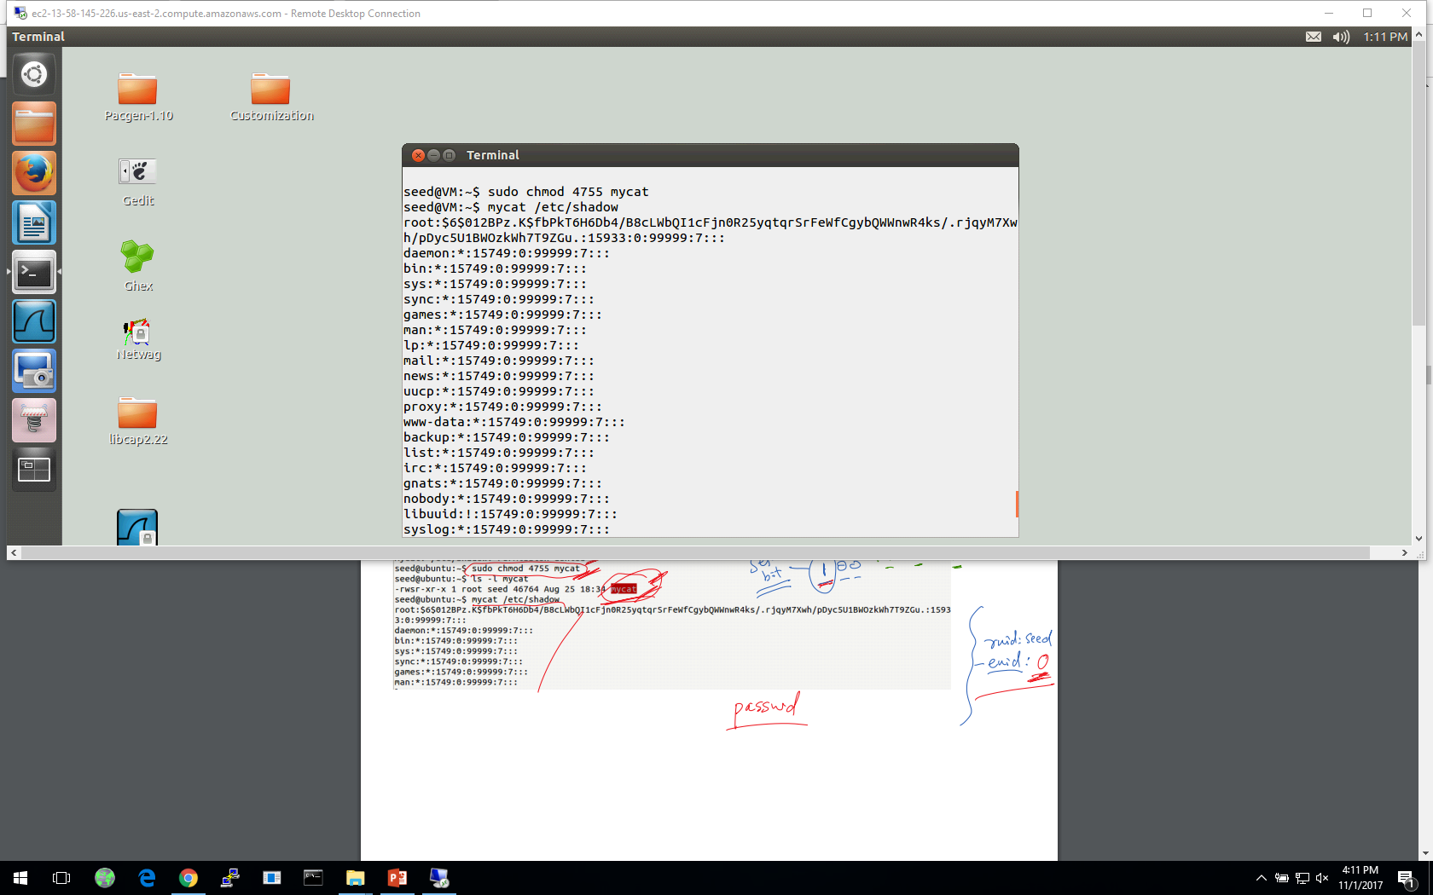
Turn a Program into Set-UID
Change the owner of a file to root :
Before Enabling Set-UID bit:
After Enabling the Set-UID bit :
Notes:
Create a program which runs like cat and change its ownership to root
Try to cat the /etc/shadow file
Convert the program into Set-UID program
Now try to cat the /etc/shadow file

Slide 9
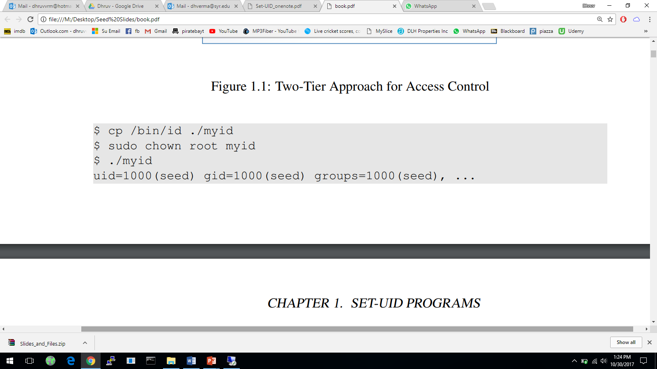
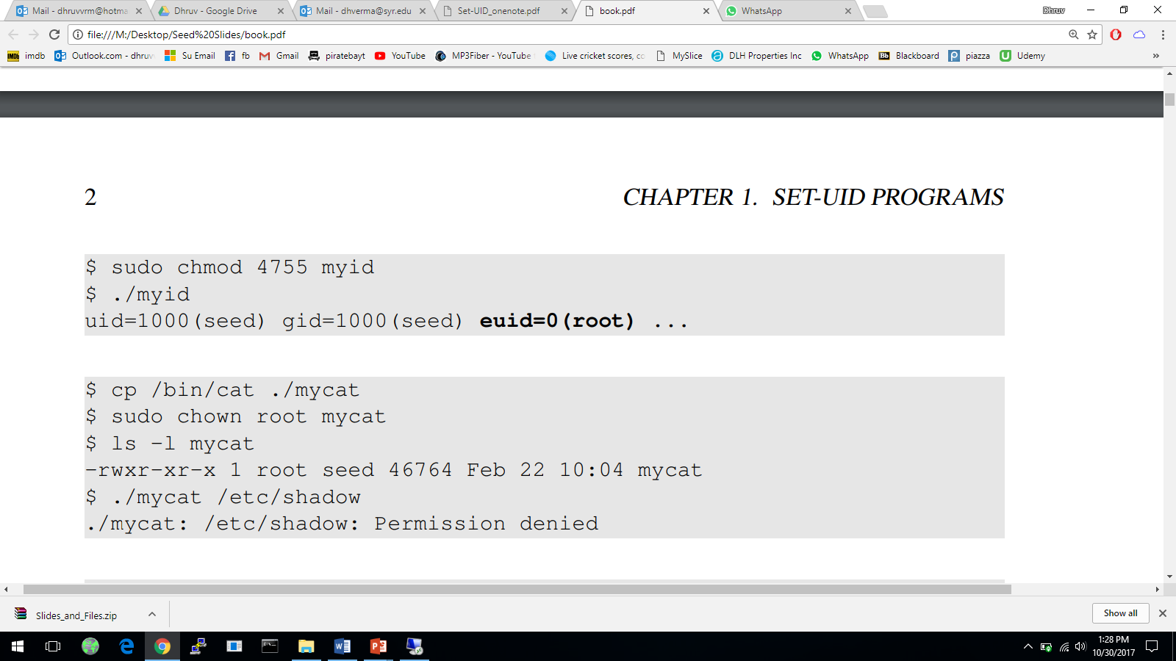
How it Works
A Set-UID program is just like any other program, except that it has a special marking, which a single bit called Set-UID bit

Slide 10
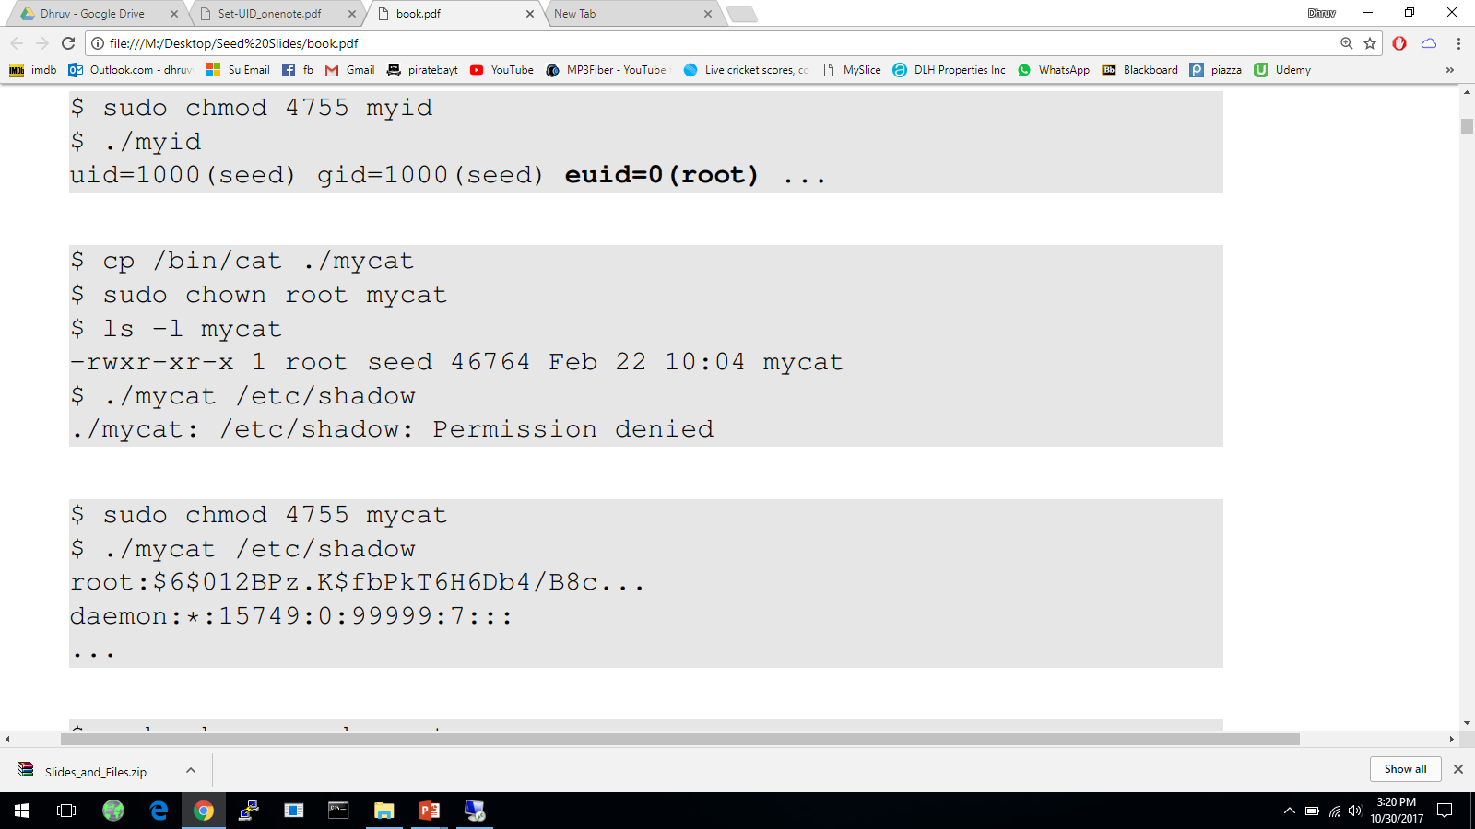
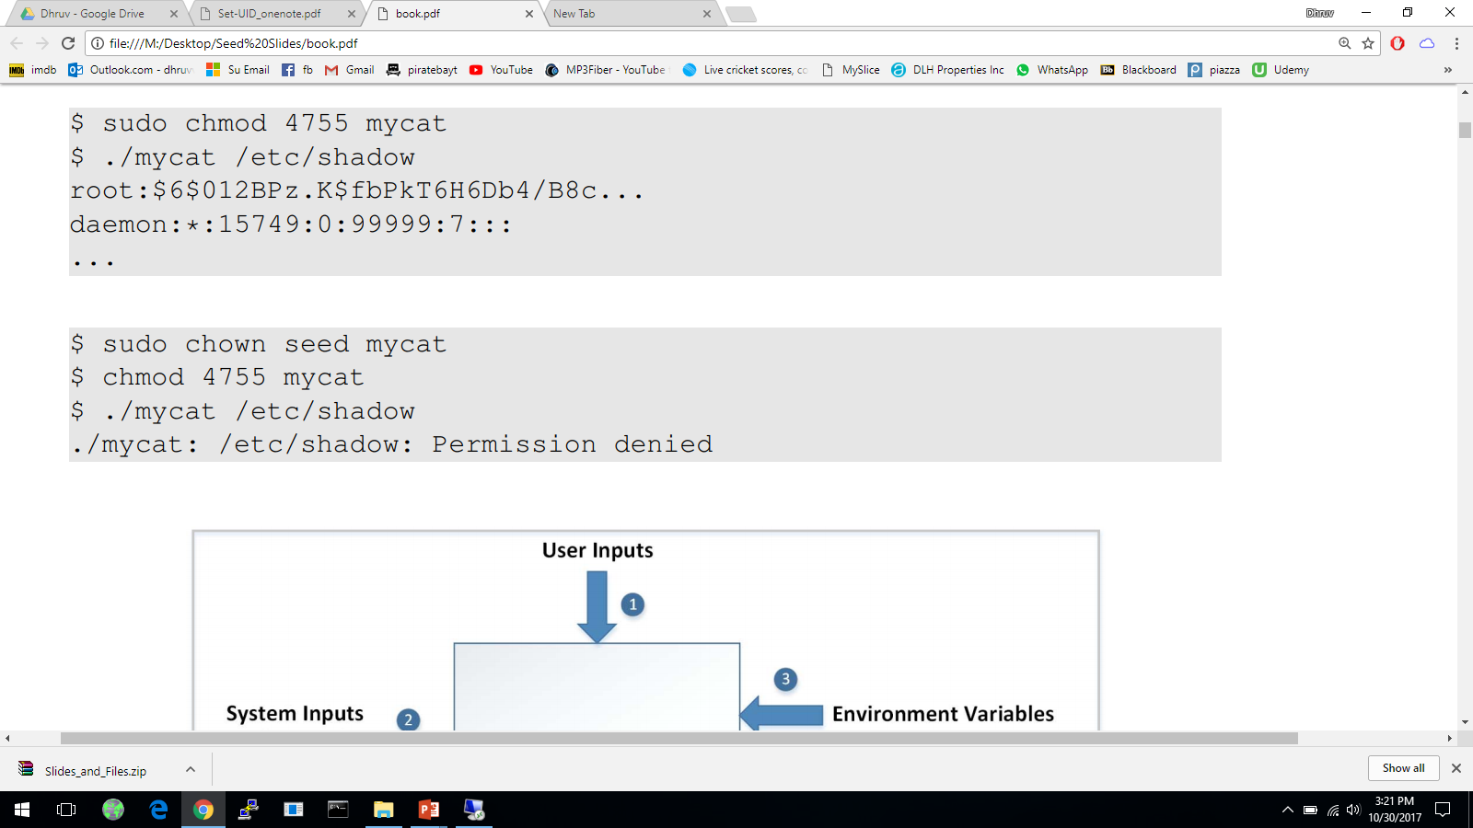

Example of Set UID
Not a privileged program
Become a privileged program
It is still a privileged program, but not the root privilege

Slide 11
How is Set-UID Secure?
Allows normal users to escalate privileges
This is different from directly giving the privilege (sudo command)
Restricted behavior – similar to superman designed computer chips
Unsafe to turn all programs into Set-UID
Example: /bin/sh
Example: vi
Notes:
Difference between set-uid and sudo
Defining why set-uid is secure and relating it to superman story
What programs should not be turned into set-uid and why?

Slide 12
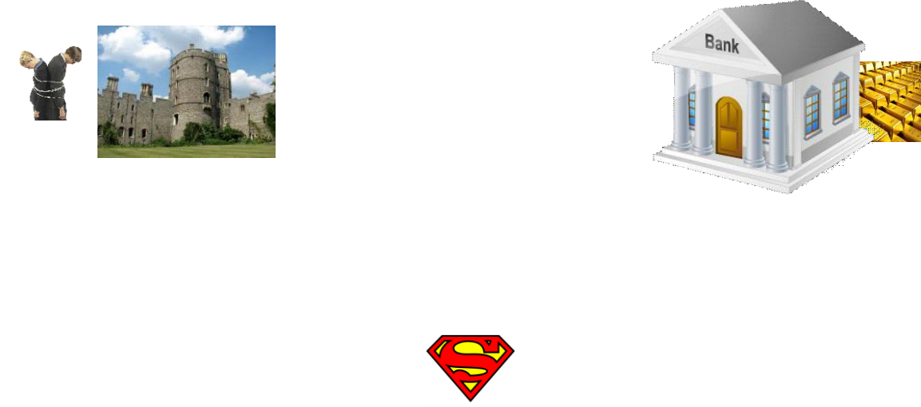
Attack on Superman
Cannot assume that user can only do whatever is coded
Coding flaws by developers
Superperson Mallroy
Fly north then turn left
How to exploit this code?
Superperson Malorie
Fly North and turn West
How to exploit this code?
1
2
Superperson is supposed to take path 1, but they take path 2
Notes:
Talking about attacks on superman’s strategy and relating it to how hackers can try to attack any mechanism

Slide 13
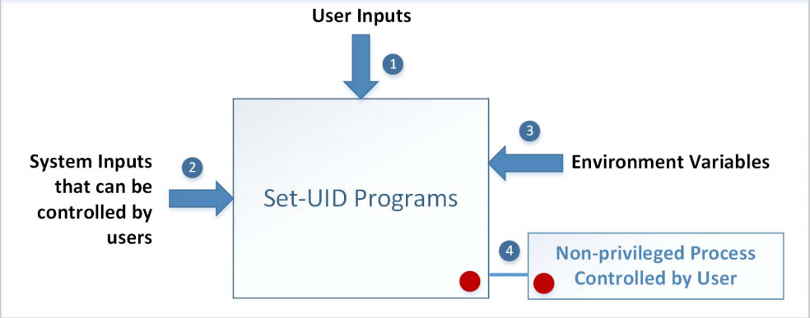
Attack Surfaces of Set-UID Programs
Notes:
Carrying on from superman story, relate it to the attack surface on set-uid programs

Slide 14
Attacks via User Inputs
User Inputs: Explicit Inputs
Buffer Overflow – More information in Chapter 4
Overflowing a buffer to run malicious code
Format String Vulnerability – More information in Chapter 6
Changing program behavior using user inputs as format strings

Slide 15
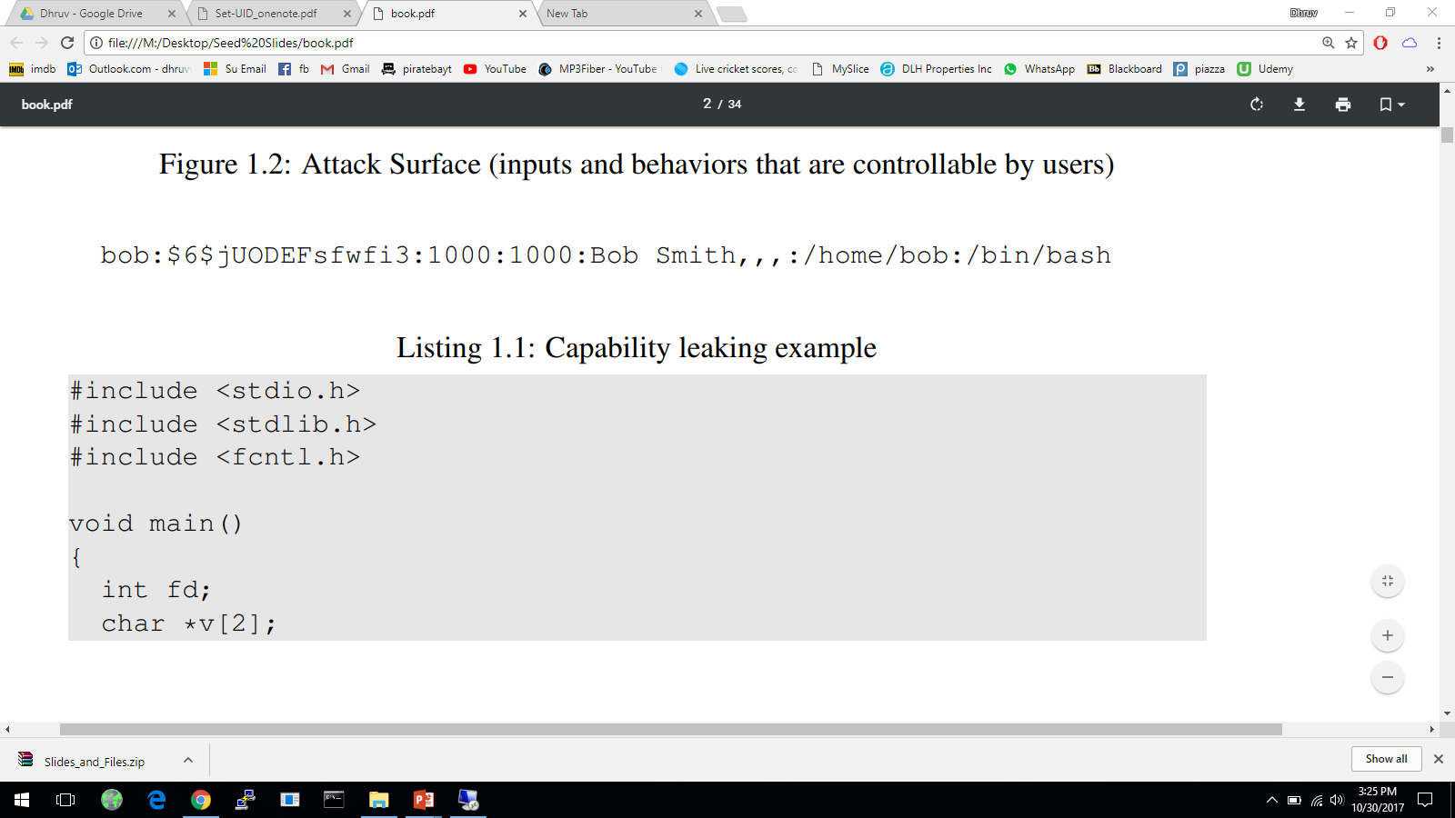
Attacks via User Inputs
CHSH – Change Shell
Set-UID program with ability to change default shell programs
Shell programs are stored in /etc/passwd file
Issues
Failing to sanitize user inputs
Attackers could create a new root account
Attack

Slide 16
Attacks via System Inputs
System Inputs
Race Condition – More information in Chapter 7
Symbolic link to privileged file from a unprivileged file
Influence programs
Writing inside world writable folder

Slide 17
Attacks via Environment Variables
Behavior can be influenced by inputs that are not visible inside a program.
Environment Variables : These can be set by a user before running a program.
Detailed discussions on environment variables will be in Chapter 2.
Notes:
What are environment variables?
What are path environment variables?
How does System() work?
How can System(“ls”) be exploited?

Slide 18
Attacks via Environment Variables
PATH Environment Variable
Used by shell programs to locate a command if the user does not provide the full path for the command
system(): call /bin/sh first
system(“ls”)
/bin/sh uses the PATH environment variable to locate “ls”
Attacker can manipulate the PATH variable and control how the “ls” command is found
More examples on this type of attacks can be found in Chapter 2
Notes:
What is path environment variable?
How does System() work?
Attack on System(“ls”)

Slide 19
Capability Leaking
In some cases, Privileged programs downgrade themselves during execution
Example: The su program
This is a privileged Set-UID program
Allows one user to switch to another user ( say user1 to user2 )
Program starts with EUID as root and RUID as user1
After password verification, both EUID and RUID become user2’s (via privilege downgrading)
Such programs may lead to capability leaking
Programs may not clean up privileged capabilities before downgrading

Slide 20
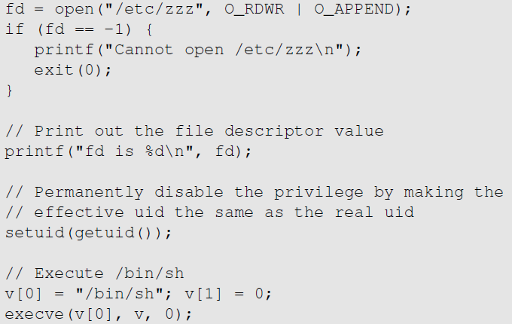
Attacks via Capability Leaking: An Example
The /etc/zzz file is only writable by root
File descriptor is created
(the program is a root-owned Set-UID program)
The privilege is downgraded
Invoke a shell program, so the behavior restriction on the program is lifted

Slide 21
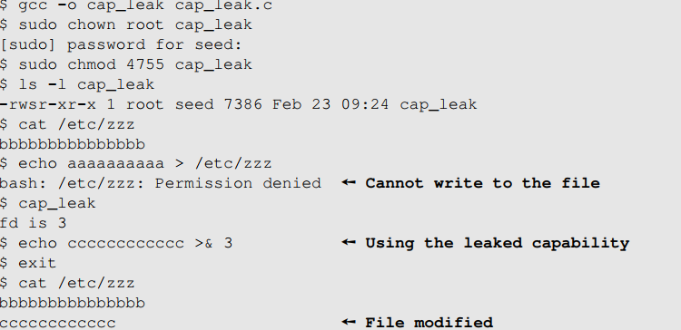
Attacks via Capability Leaking (Continued)
The program forgets to close the file, so the file descriptor is still valid.
Capability Leak
How to fix the program?
Destroy the file descriptor before downgrading the privilege (close the file)

Slide 22
Capability Leaking in OS X – Case Study
OS X Yosemite found vulnerable to privilege escalation attack related to capability leaking in July 2015 ( OS X 10.10 )
Added features to dynamic linker dyld
DYLD_PRINT_TO_FILE environment variable
The dynamic linker can open any file, so for root-owned Set-UID programs, it runs with root privileges. The dynamic linker dyld, does not close the file. There is a capability leaking.
Scenario 1 (safe): Set-UID finished its job and the process dies. Everything is cleaned up and it is safe.
Scenario 2 (unsafe): Similar to the “su” program, the privileged program downgrade its privilege, and lift the restriction.
Notes:
Talk about the case study
Different scenarios
Why scenario 2 is vulnerable and how
Fix

Slide 23
Invoking Programs
Invoking external commands from inside a program
External command is chosen by the Set-UID program
Users are not supposed to provide the command (or it is not secure)
Attack:
Users are often asked to provide input data to the command.
If the command is not invoked properly, user’s input data may be turned into command name. This is dangerous.

Slide 24
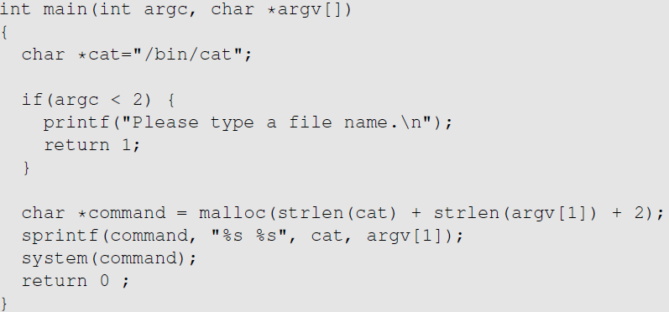
Invoking Programs : Unsafe Approach
The easiest way to invoke an external command is the system() function.
This program is supposed to run the /bin/cat program.
It is a root-owned Set-UID program, so the program can view all files, but it can’t write to any file.
Question: Can you use this program to run other command, with the root privilege?

Slide 25
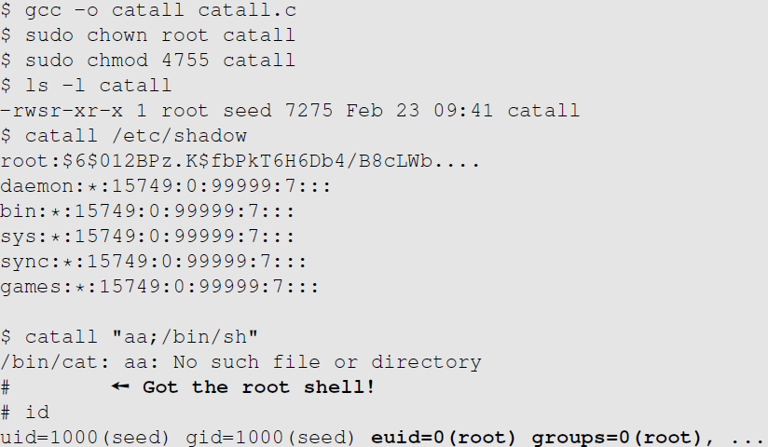
Invoking Programs : Unsafe Approach ( Continued)
Problem: Some part of the data becomes code (command name)
We can get a root shell with this input

Slide 26
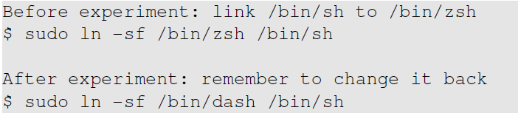
A Note
In Ubuntu 16.04, /bin/sh points to /bin/dash, which has a countermeasure
It drops privilege when it is executed inside a set-uid process
Therefore, we will only get a normal shell in the attack on the previous slide
Do the following to remove the countermeasure

Slide 27
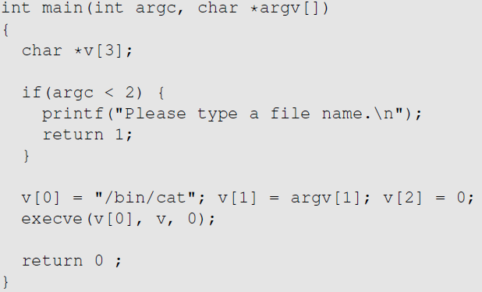
Invoking Programs Safely: using execve()
execve(v[0], v, 0)
Command name is provided here (by the program)
Input data are provided here (can be by user)
Why is it safe?
Code (command name) and data are clearly separated; there is no way for the user data to become code

Slide 28
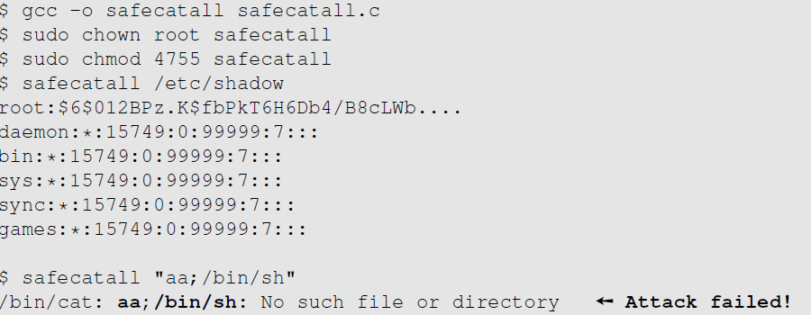
Invoking Programs Safely ( Continued)
The data are still treated as data, not code

Slide 29
Additional Consideration
Some functions in the exec() family behave similarly to execve(), but may not be safe
execlp(), execvp() and execvpe() duplicate the actions of the shell. These functions can be attacked using the PATH Environment Variable

Slide 30
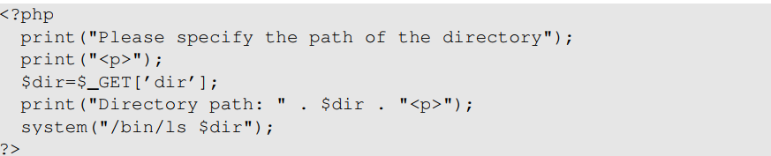
Invoking External Commands in Other Languages
Risk of invoking external commands is not limited to C programs
We should avoid problems similar to those caused by the system() functions
Examples:
Perl: open() function can run commands, but it does so through a shell
PHP: system() function
Attack:
http://localhost/list.php?dir=.;date
Command executed on server : “/bin/ls .;date”

Slide 31
Principle of Isolation
Principle: Don’t mix code and data.
Attacks due to violation of this principle :
system() code execution
Cross Site Scripting – More Information in Chapter 10
SQL injection - More Information in Chapter 11
Buffer Overflow attacks - More Information in Chapter 4

Slide 32
Principle of Least Privilege
A privileged program should be given the power which is required to perform it’s tasks.
Disable the privileges (temporarily or permanently) when a privileged program doesn’t need those.
In Linux, seteuid() and setuid() can be used to disable/discard privileges.
Different OSes have different ways to do that.

Slide 33
Summary
The need for privileged programs
How the Set-UID mechanism works
Security flaws in privileged Set-UID programs
Attack surface
How to improve the security of privileged programs

Slide 34
Environment Variables & Attacks

Slide 35
Environment Variables
A set of dynamic named values
Part of the operating environment in which a process runs
Affect the way that a running process will behave
Introduced in Unix and also adopted by Microsoft Windows
Example: PATH variable
When a program is executed the shell process will use the environment variable to find where the program is, if the full path is not provided.
Notes:
Define what environment variables are

Slide 36
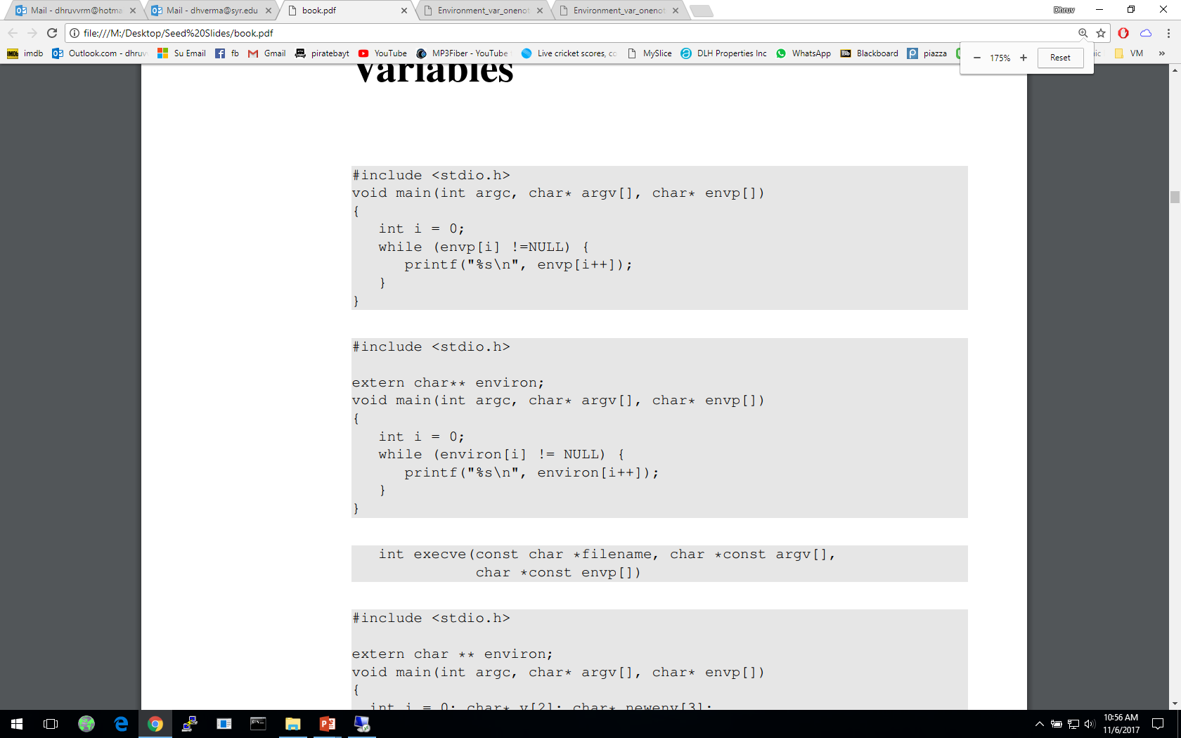
How to Access Environment Variables
From the main function
More reliable way:
Using the global variable
Notes:
Ways of accessing environment variables
envp[] and environ
Recommended approach is to use environ – reason explained in following slides

Slide 37
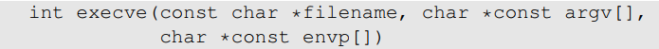
How Does a process get Environment Variables?
Process can get environment variables one of two ways:
If a new process is created using fork() system call, the child process will inherits its parent process’s environment variables.
If a process runs a new program in itself, it typically uses execve() system call. In this scenario, the memory space is overwritten and all old environment variables are lost. execve() can be invoked in a special manner to pass environment variables from one process to another.
Passing environment variables when invoking execve() :
Notes:
Getting environment variables
3rd argument in execve() system call

Slide 38
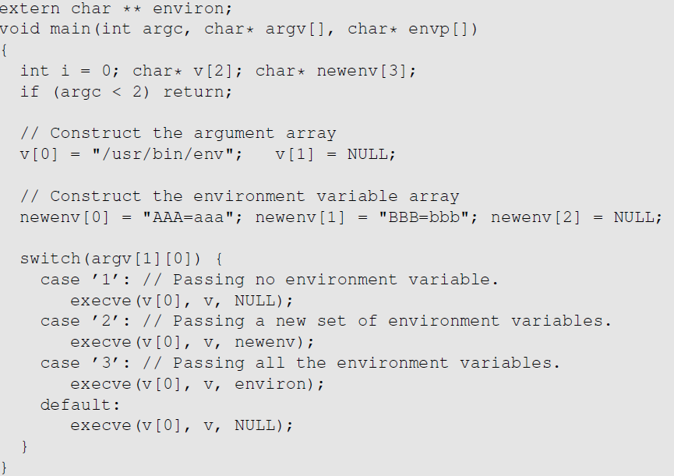
execve() and Environment variables
The program executes a new program /usr/bin/env, which prints out the environment variables of the current process.
We construct a new variable newenv, and use it as the 3rd argument.

Slide 39
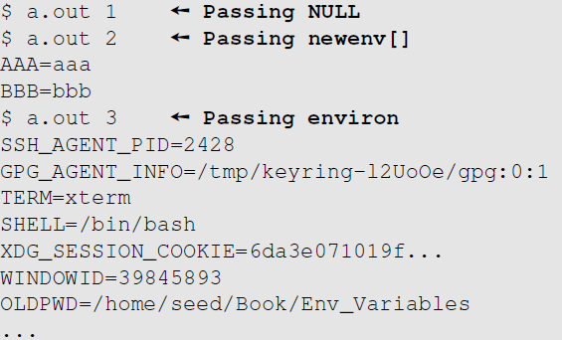
execve() and Environment variables
Obtained from the parent process
Notes:
Getting environment variables
3rd argument in execve() system call

Slide 40
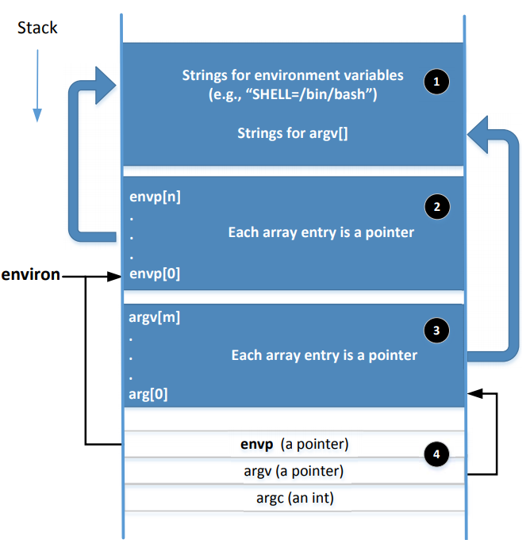
Memory Location for Environment Variables
envp and environ points to the same place initially.
envp is only accessible inside the main function, while environ is a global variable.
When changes are made to the environment variables (e.g., new ones are added), the location for storing the environment variables may be moved to the heap, so environ will change (envp does not change)
Notes:
Adding or deleting environment variables or modifying the value of existing one, there not be enough space in 1 & 2. In this case, the entire environment variable block may change to a different location (usually in the heap)
When this change happens, the environ variable should be changed accordingly
A program can change their environment variables using putenv(), setenv() etc

Slide 41
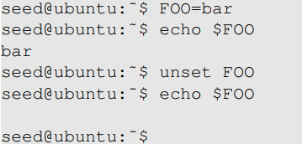
Shell Variables & Environment Variables
People often mistake shell variables and environment variables to be the same.
Shell Variables:
Internal variables used by shell.
Shell provides built-in commands to allow users to create, assign and delete shell variables.
In the example, we create a shell variable called FOO.

Slide 42
Side Note on The /proc File System
/proc is a virtual file system in linux. It contains a directory for each process, using the process ID as the name of the directory
Each process directory has a virtual file called environ, which contains the environment of the process.
e.g., virtual file /proc/932/environ contains the environment variable of process 932
The command “strings /proc/$$/environ” prints out the environment variable of the current process (shell will replace $$ with its own process ID)
When env program is invoked in a bash shell, it runs in a child process. Therefore, it print out the environment variables of the shell’s child process, not its own.

Slide 43
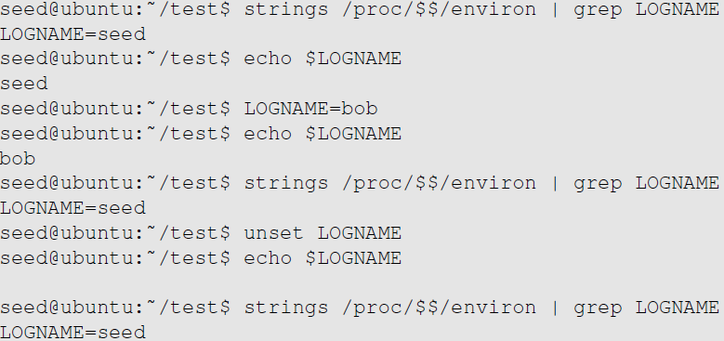
Shell Variables & Environment Variables
Shell variables and environment variables are different
When a shell program starts, it copies the environment variables into its own shell variables. Changes made to the shell variable will not reflect on the environment variables, as shown in example :
Environment variable
Shell variable
Shell variable is changed
Environment variable is the same
Shell variable is gone
Environment variable is still here
Notes:
Explain /proc/$$/environ: $$ will be replaced by the shell with the current process’s ID, so /proc/$$/environ basically contains the environment variables of the current process.

Slide 44
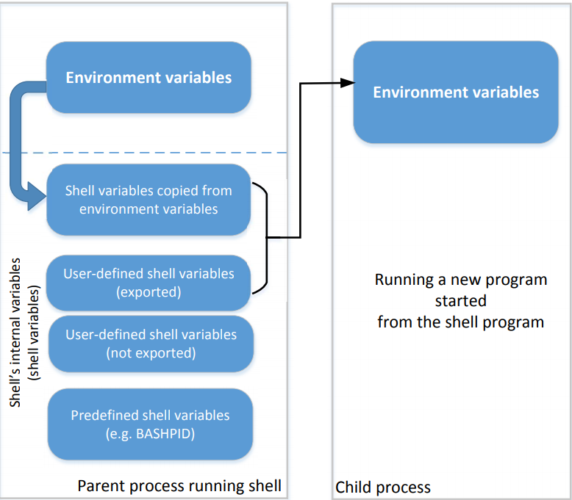
Shell Variables & Environment Variables
This figure shows how shell variables affect the environment variables of child processes
It also shows how the parent shell’s environment variables becomes the child process’s environment variables (via shell variables)
Notes:
How do shell variables become environment variables and why?
Fork()
Execve()
Which type of shell variables become the new environment variables?
Shell variables copied from environment variables
User defined shell variables using “export”
Example in next slide

Slide 45
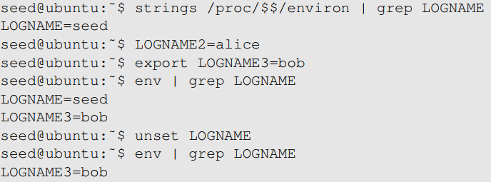
Shell Variables & Environment Variables
When we type env in shell prompt, shell will create a child process
Print out environment variable
Only LOGNAME and LOGNAME3 get into the child process, but not LOGNAME2. Why?
Notes:
Reason behind only LOGNAME and LOGNAME3 being printing
Unset function
How env is run as a child process is in next slide.

Slide 46
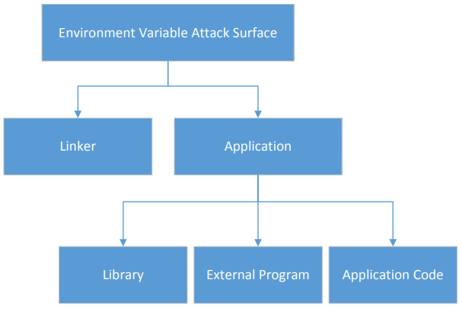
Attack Surface on Environment Variables
Hidden usage of environment variables is dangerous.
Since users can set environment variables, they become part of the attack surface on Set-UID programs.
Notes:
Overview of each of the parts and what they do
Linker
Library
External program
Application code

Slide 47
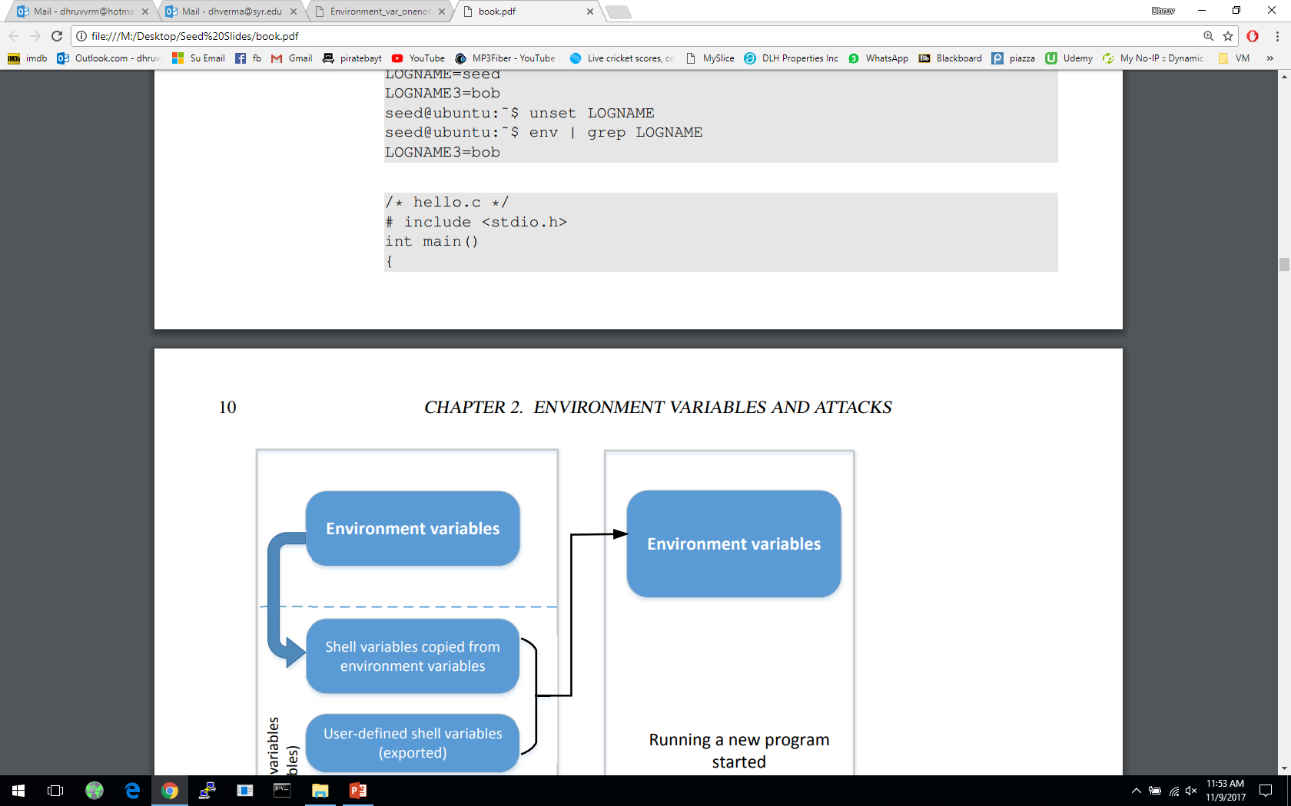
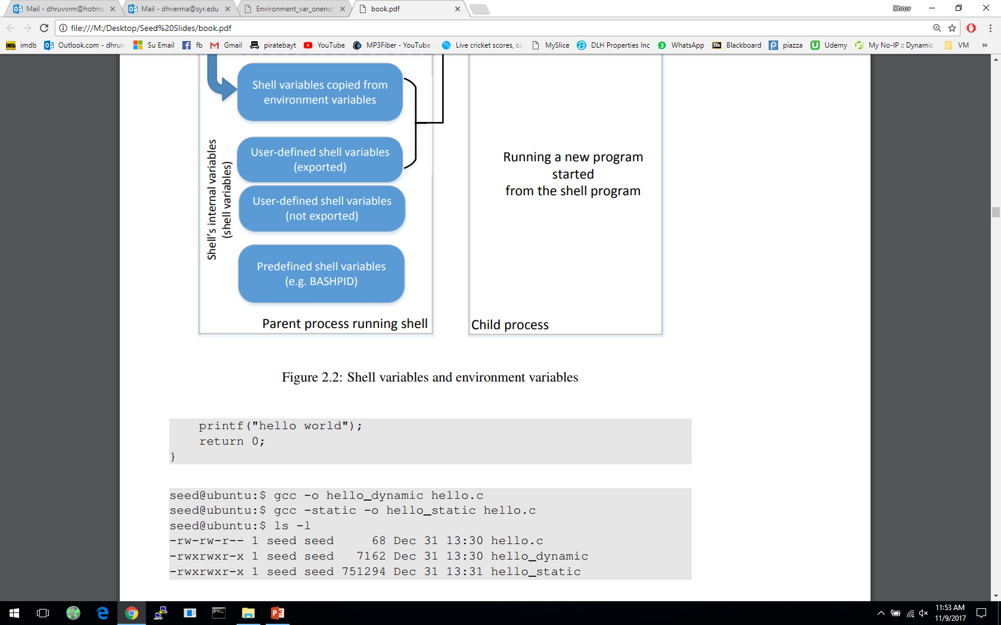
Attacks via Dynamic Linker
Linking finds the external library code referenced in the program
Linking can be done during runtime or compile time:
Dynamic Linking – uses environment variables, which becomes part of the attack surface
Static Linking
We will use the following example to differentiate static and dynamic linking:

Slide 48
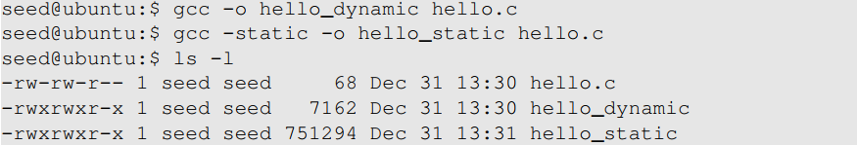
Attacks via Dynamic Linker
Static Linking
The linker combines the program’s code and the library code containing the printf() function
We can notice that the size of a static compiled program is 100 times larger than a dynamic program
Notes:
Static linking copies code and wastes a lot of memory
In time of a security path, everything will have to patched manually
Hence, dynamic linking is the recommended approach

Slide 49
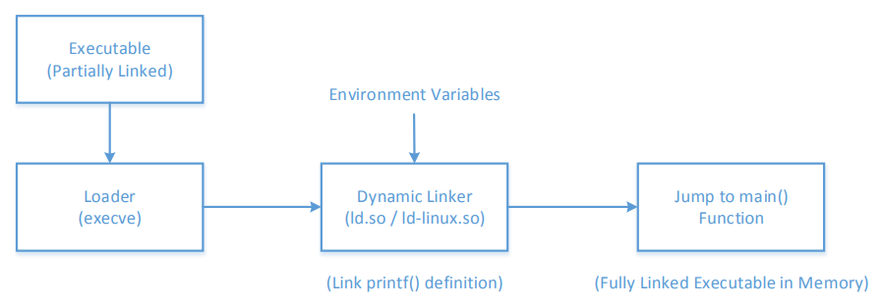
Attacks via Dynamic Linker
Dynamic Linking
The linking is done during runtime
Shared libraries (DLL in windows)
Before a program compiled with dynamic linking is run, its executable is loaded into the memory first
Notes:
What are shared libraries?
After loading into memory, loader passes control to dynamic linker
Linker finds implementation of printf() for shared libraries
Once linking is complete the control is given to main(0

Slide 50
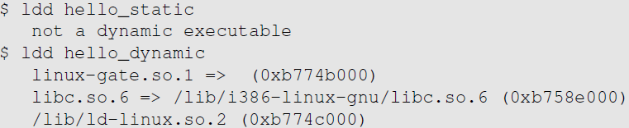
Attacks via Dynamic Linker
Dynamic Linking:
We can use “ldd” command to see what shared libraries a program depends on :
for system calls
The dynamic linker itself is in a shared library. It is invoked before the main function gets invoked.
The libc library (contains functions like printf() and sleep())

Slide 51
Attacks via Dynamic Linker: the Risk
Dynamic linking saves memory
This means that a part of the program’s code is undecided during the compilation time
If the user can influence the missing code, they can compromise the integrity of the program

Slide 52
Attacks via Dynamic Linker: Case Study 1
LD_PRELOAD contains a list of shared libraries which will be searched first by the linker
If not all functions are found, the linker will search among several lists of folder including the one specified by LD_LIBRARY_PATH
Both variables can be set by users, so it gives them an opportunity to control the outcome of the linking process
If that program were a Set-UID program, it may lead to security breaches

Slide 53
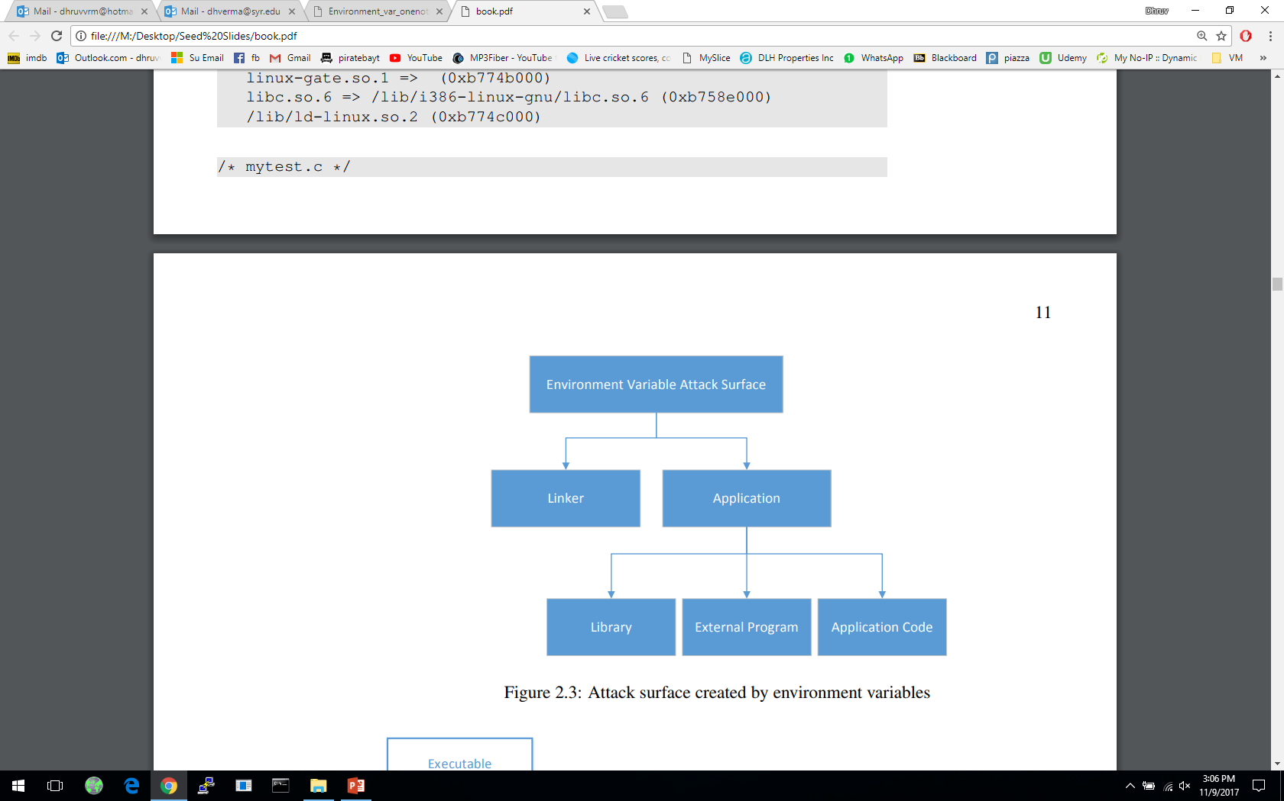
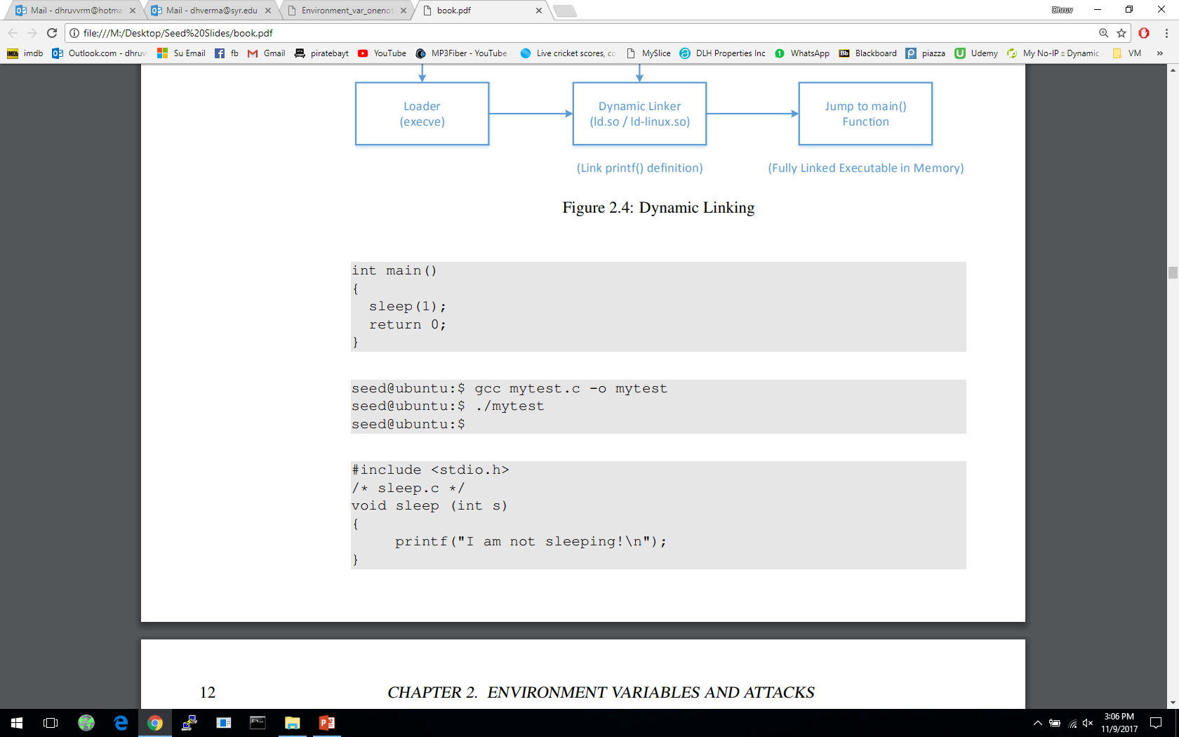
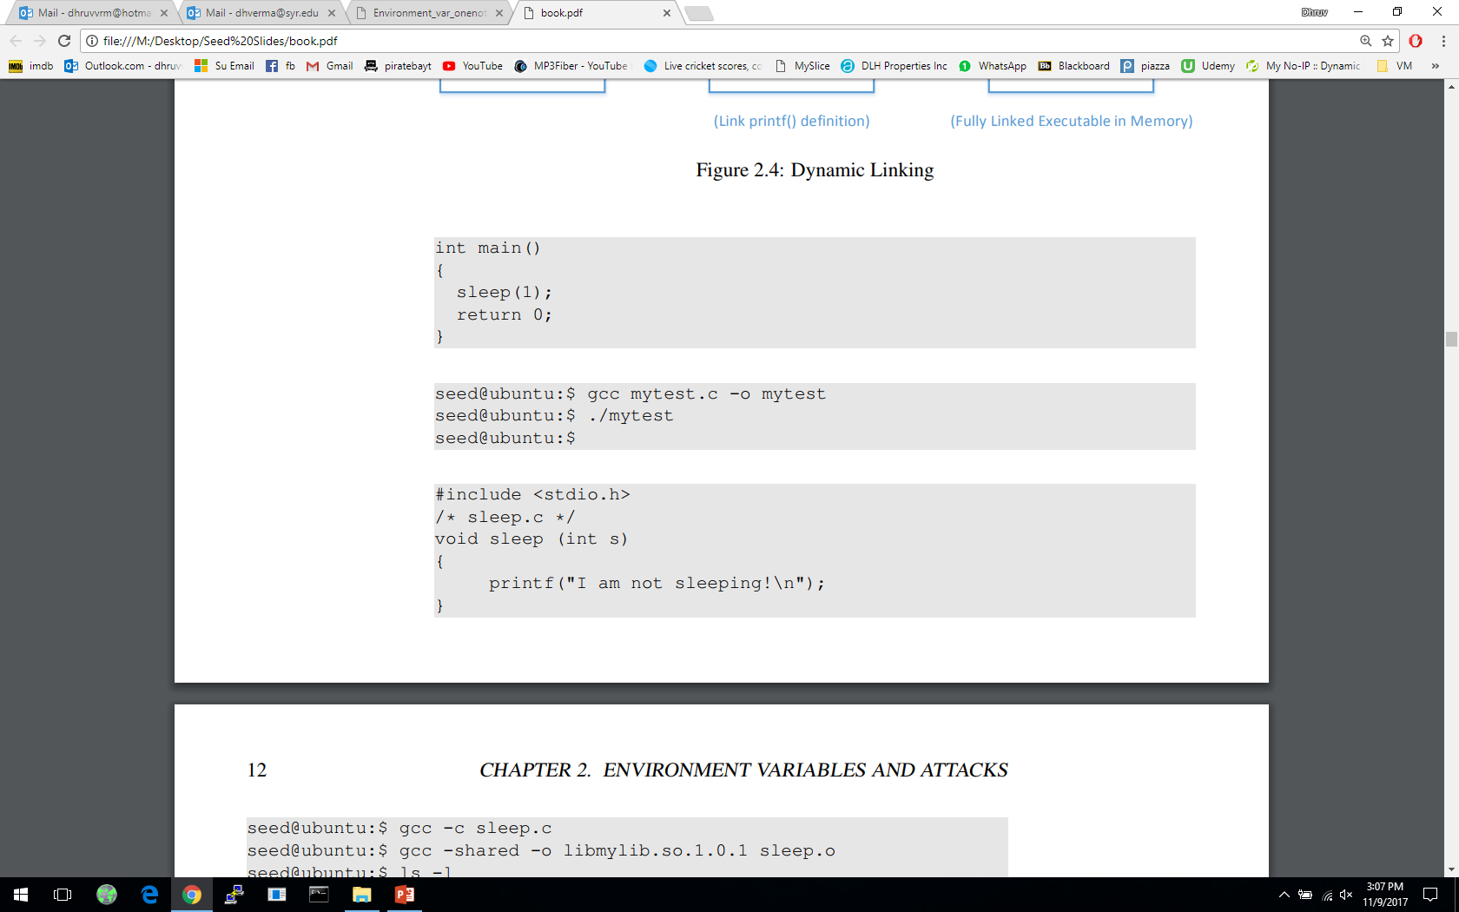
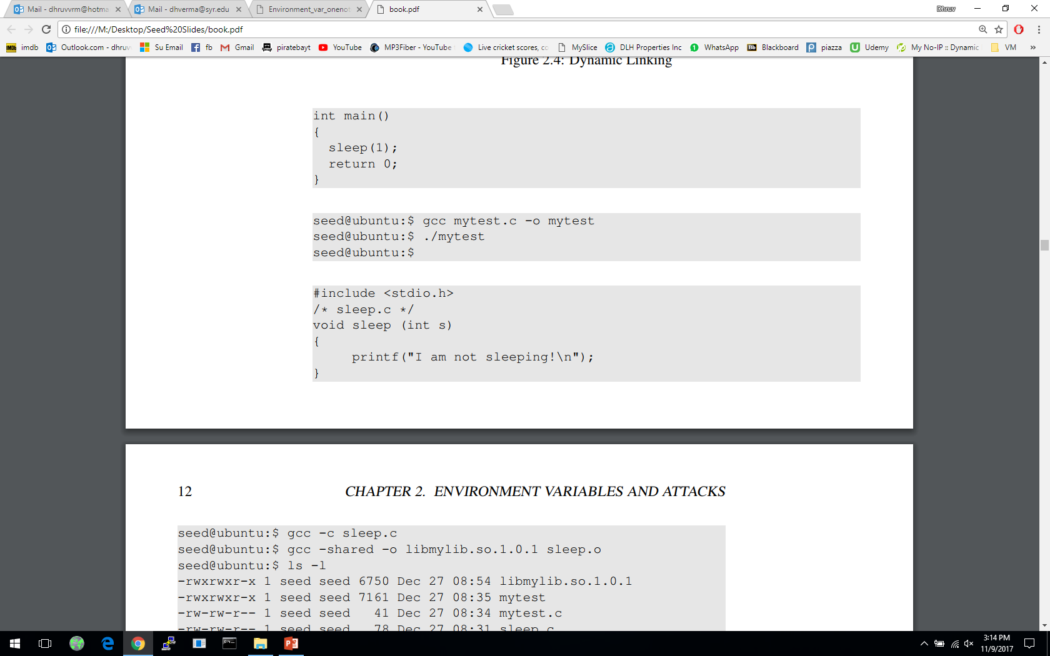
Attacks via Dynamic Linker: Case Study 1
Example 1 – Normal Programs:
Program calls sleep function which is dynamically linked:
Now we implement our own sleep() function:

Slide 54
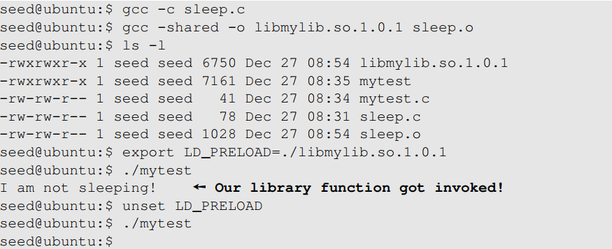
Attacks via Dynamic Linker: Case Study 1
Example 1 – Normal Programs ( continued ):
We need to compile the above code, create a shared library and add the shared library to the LD_PRELOAD environment variable

Slide 55
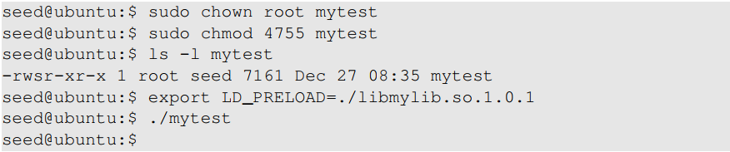
Attacks via Dynamic Linker: Case Study
Example 2 – Set-UID Programs:
If the technique in example 1 works for Set-UID program, it can be very dangerous. Lets convert the above program into Set-UID :
Our sleep() function was not invoked.
This is due to a countermeasure implemented by the dynamic linker. It ignores the LD_PRELOAD and LD_LIBRARY_PATH environment variables when the EUID and RUID differ.
Lets verify this countermeasure with an example in the next slide.

Slide 56
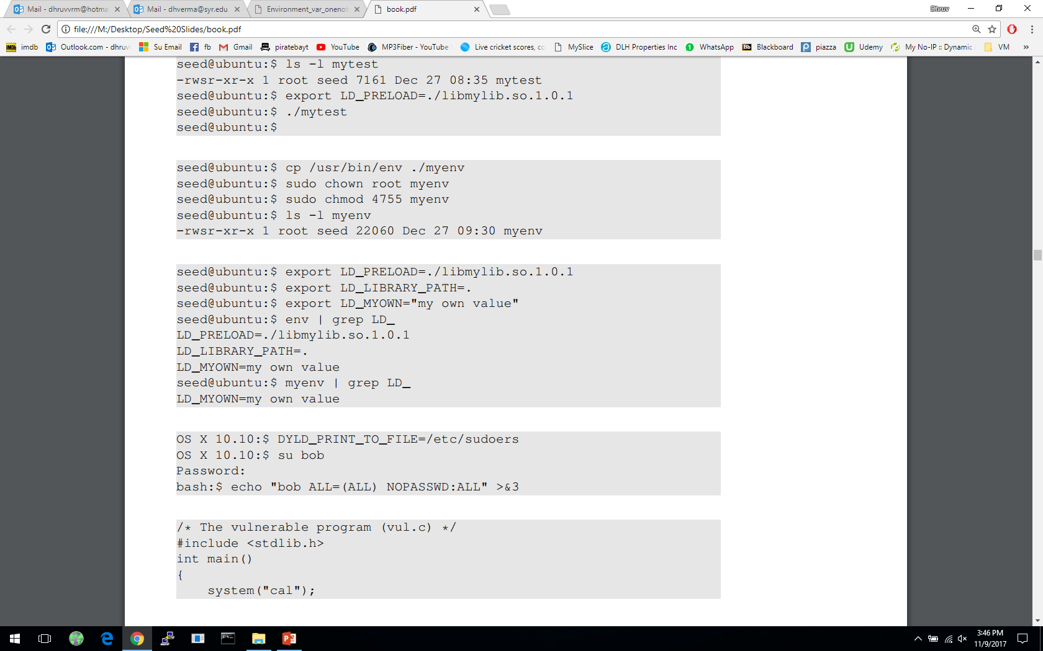

Attacks via Dynamic Linker
Let’s verify the countermeasure
Make a copy of the env program and make it a Set-UID program :
Export LD_LIBRARY_PATH and LD_PRELOAD and run both the programs:
Run the original env program
Run our env program
Notes:
Even though both the programs are identical, we see a difference.
myenv does not even display those two environment variables .
The LD_PRELOAD defined by us poses no threat.

Slide 57
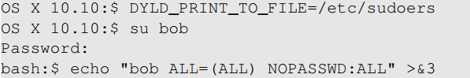
Attacks via Dynamic Linker: Case Study 2
Case study: OS X Dynamic Linker
As discussed in Chapter 1 (in capability leaking ), apple OS X 10.10 introduced a new environment variable without analyzing its security implications perfectly.
DYLD_PRINT_TO_FILE
Ability for users to supply filename for dyld
If it is a Set-UID program, users can write to a protected file
Capability leak – file descriptor not closed
Exploit example:
Set DYLD_PRINT_TO_FILE to /etc/sudoers
Switch to Bob’s account
The echo command writes to /etc/sudoers
Notes:
Review of the capability leaking case
Bob potentially gets access to root account

Slide 58
Attacks via External Program
An application may invoke an external program.
The application itself may not use environment variables, but the invoked external program might.
Typical ways of invoking external programs:
exec() family of function which call execve(): runs the program directly
system()
The system() function calls execl()
execl()eventually calls execve()to run /bin/sh
The shell program then runs the program
Attack surfaces differ for these two approaches
We have discussed attack surfaces for such shell programs in Chapter 1. Here we will focus on the Environment variables aspect.
Notes:
The attack surface expands for a privileged program when they invoke an external program

Slide 59
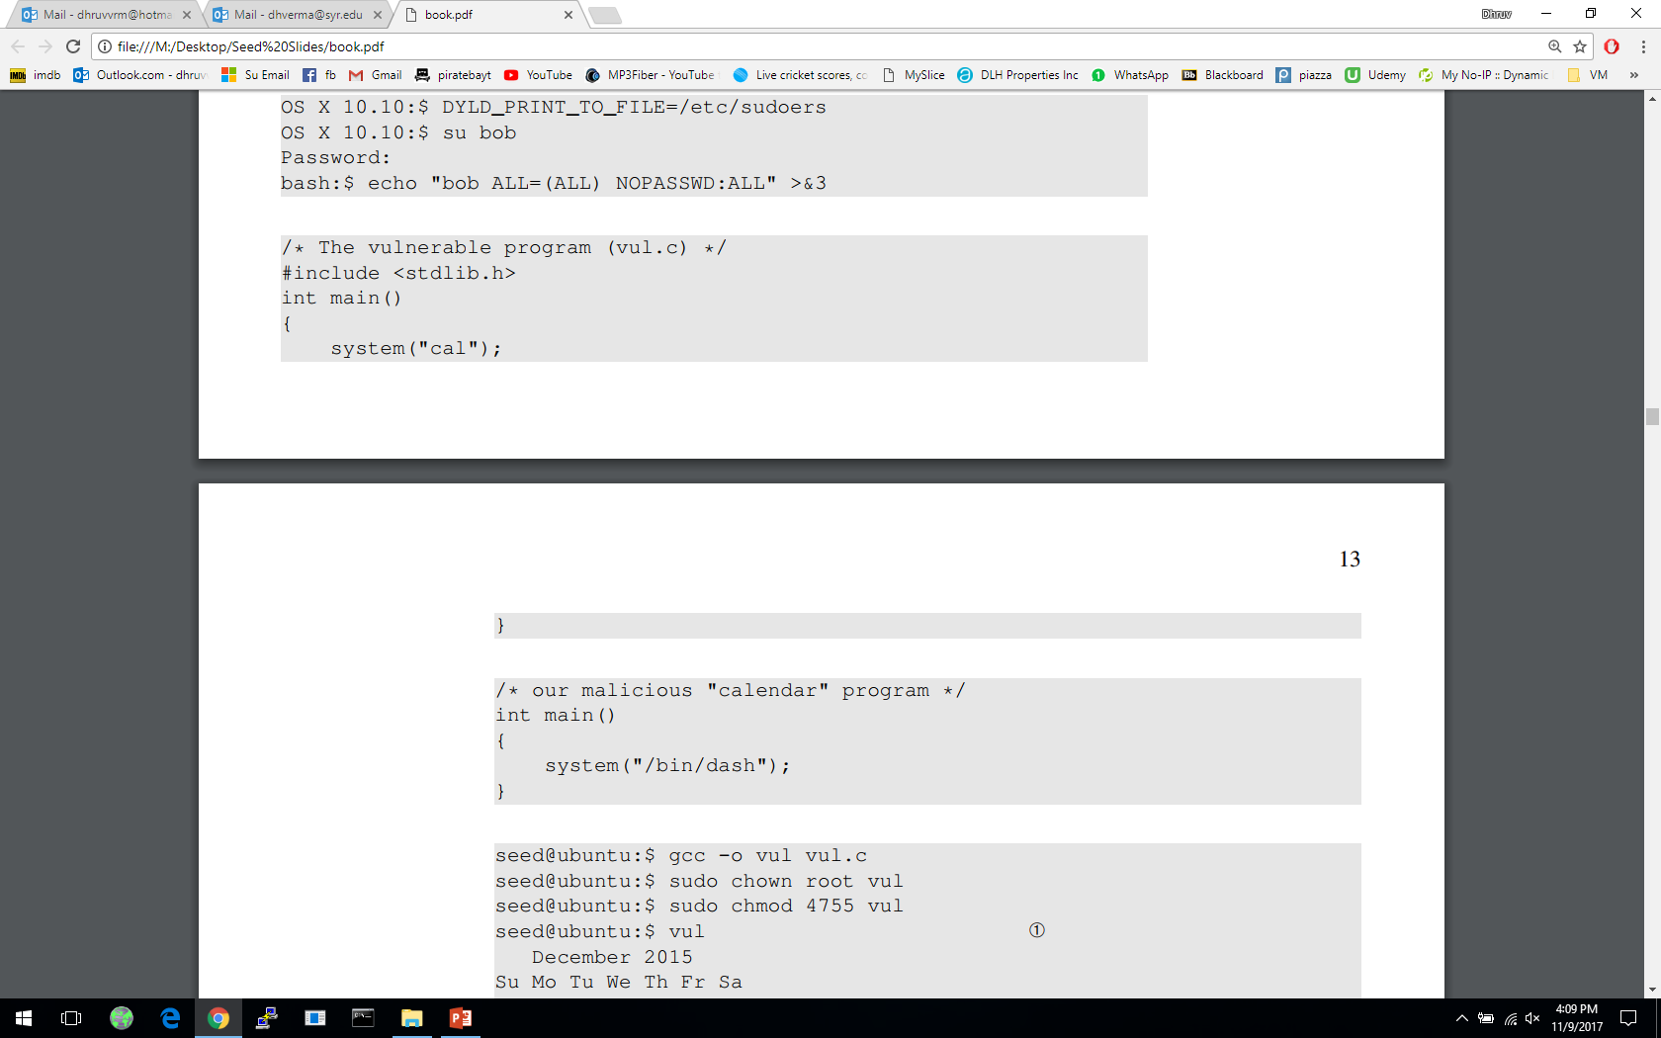
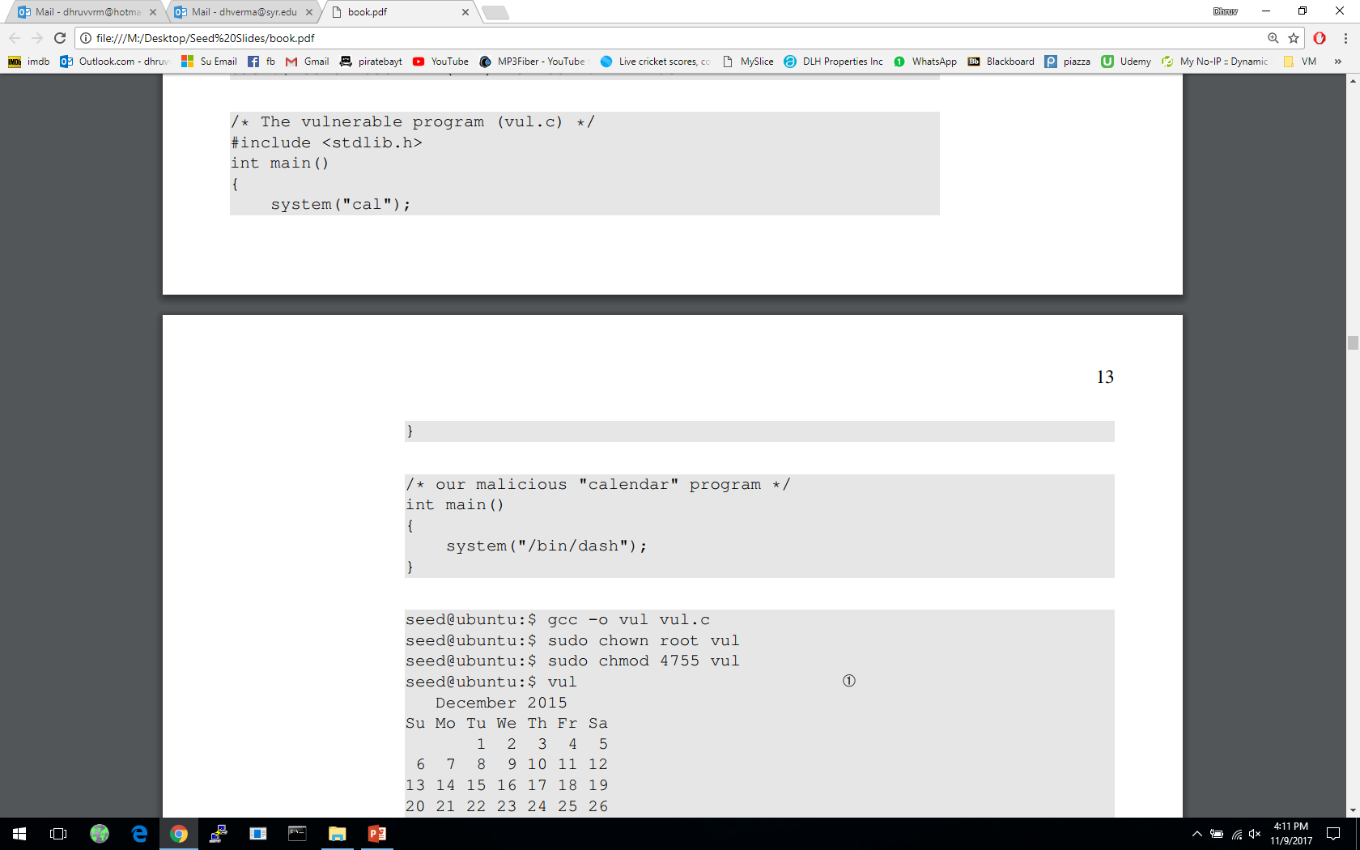
Attacks via External Program: Case Study
Shell programs behavior is affected by many environment variables, the most common of which is the PATH variable.
When a shell program runs a command and the absolute path is not provided, it uses the PATH variable to locate the command.
Consider the following code:
We will force the above program to execute the following program :
Full path not provided. We can use this to manipulate the path variable

Slide 60
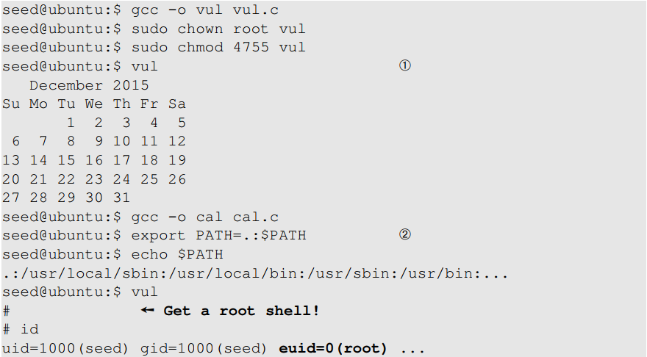
Attacks via External Program: Case Study
We will first run the first program without doing the attack
We now change the PATH environment variable

Slide 61
Attacks via External Program: Attack Surfaces
Compared to system(), execve()’s attack surface is smaller
execve() does not invoke shell, and thus is not affected by environment variables
When invoking external programs in privileged programs, we should use execve()
Refer to Chapter 1 for more information

Slide 62
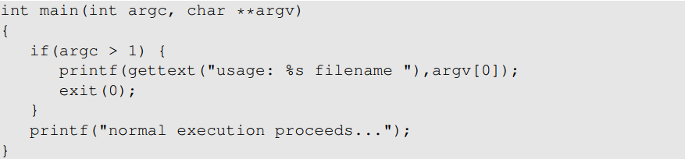
Attacks via Library
Programs often use functions from external libraries. If these functions use environment variables, they add to the attack surface
Case Study – Locale in UNIX
Every time a message needs to be printed out, the program uses the provided library functions for the translated message
Unix uses the gettext() and catopen() in the libc library
The following code shows how a program can use locale subsystem :
Notes:
What is locale subsystem?
Consists of a set of a set of databases and library functions
Store language and country specific information

Slide 63
Attacks via Library
This subsystem relies on the following environment variables : LANG, LANGUAGE, NLSPATH, LOCPATH, LC_ALL, LC_MESSAGES
These variables can be set by users, so the translated message can be controlled by users.
Attacker can use format string vulnerability to format the printf() function – More information in chapter 6
Countermeasure:
This lies with the library author
Example: Conectiva Linux using the Glibc 2.1.1 library explicitly checks and ignored the NSLPATH environment variable if catopen() and catgets() functions are called from a Set-UID program

Slide 64
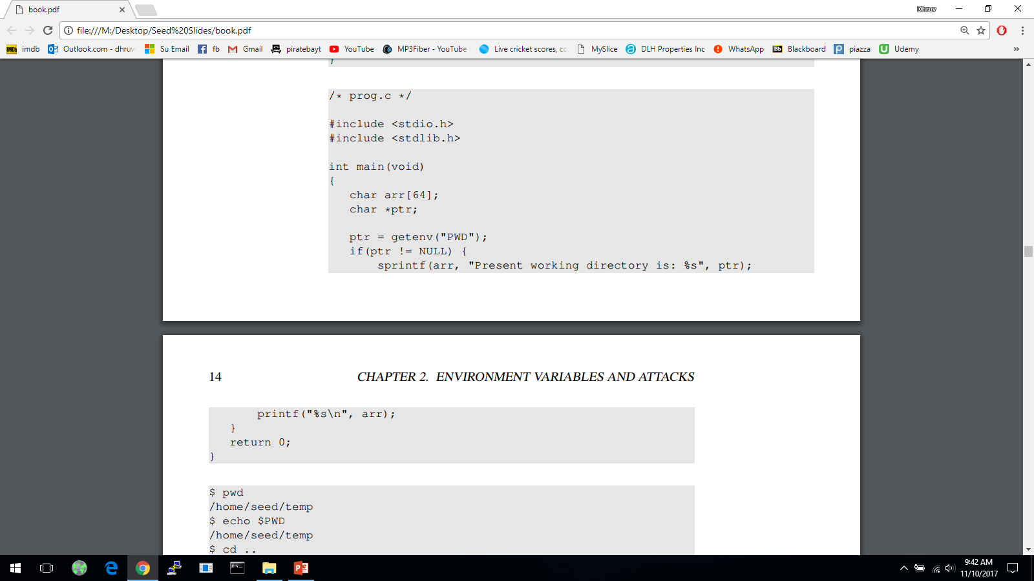
Attacks via Application Code
Programs may directly use environment variables. If these are privileged programs, it may result in untrusted inputs.

Slide 65
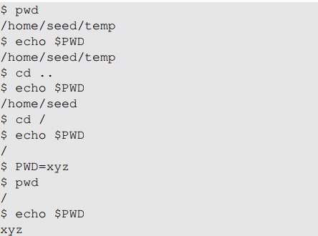
Attacks via Application Code
The program uses getenv() to know its current directory from the PWD environment variable
The program then copies this into an array “arr”, but forgets to check the length of the input. This results in a potential buffer overflow.
Value of PWD comes from the shell program, so every time we change our folder the shell program updates its shell variable.
We can change the shell variable ourselves.
Current directory with unmodified shell variable
Current directory with modified shell variable
Notes:
When a command is executed from shell, a new process will be created
The shell sets this new process’s environment variable PWD using shell variable
Hence, the value can be tampered with by the user
If this program were a Set-UID users could exploit it by setting the PWD variable to a arbitrary long string.
Attackers can further exploit the buffer overflow to gain privileges

Slide 66
Attacks via Application Code - Countermeasures
When environment variables are used by privileged Set-UID programs, they must be sanitized properly.
Developers may choose to use a secure version of getenv(), such as secure_getenv().
getenv() works by searching the environment variable list and returning a pointer to the string found, when used to retrieve a environment variable.
secure_getenv() works the exact same way, except it returns NULL when “secure execution” is required.
Secure execution is defined by conditions like when the process’s user/group EUID and RUID don’t match

Slide 67
Set-UID Approach VS Service Approach
Normal-User Process
Privileged Process
Environment
Variables
Environment
Variables
Request for service
Privileged Process
(Conduct privileged operations
for users)
Privileged Process
(Conduct privileged operations
for users)
Normal User Process
(a) Set-UID Approach
(b) Service Approach

Slide 68
Set-UID Approach VS Service Approach
Most operating systems follow two approaches to allow normal users to perform privileged operations
Set-UID approach: Normal users have to run a special program to gain root privileges temporarily
Service approach: Normal users have to request a privileged service to perform the actions for them. Figure in the earlier slide depicts these two approaches
Set-UID has a much broader attack surface, which is caused by environment variables
Environment variables cannot be trusted in Set-UID approach
Environment variables can be trusted in Service approach
Although, the other attack surfaces still apply to Service approach (Discussed in Chapter 1), it is considered safer than Set-UID approach
Due to this reason, the Android operating system completely removed the Set-UID and Set-GID mechanism
Notes:
From the functionality perspective, Set-UID performs better. This is because it does not require a running background process.
From the security perspective, Set-UID approach has a much broader attack surface
Describe part (a) of figure in previous slide – how environment variables come from a normal process and cannot be trusted
Describe part (b) of figure in previous slide – how service is started by a privileged parent process, so the environment variables comes from a trusted source. Although attackers can still attack using other attack surfaces, there is no way for them to do it using environment variables
Android which is built on top of Linux removed the Set-UID and Set-GID mechanism

Slide 69
Summary
What are environment variables
How they get passed from one process to its children
How environment variables affect the behaviors of programs
Risks introduced by environment variables
Case studies
Attack surface comparison between Set-UID and service approaches

